Slide 1

The Future Of Learning – It is Already Here!
September 11, 2015

Slide 2
Objectives/Agenda
Further explore what we know about learners today
Share our approach to accelerating development at Deloitte
Share our vision for continuing professional development at Deloitte
Explore the future of CPE

Slide 3
What we know about learners today

Slide 4
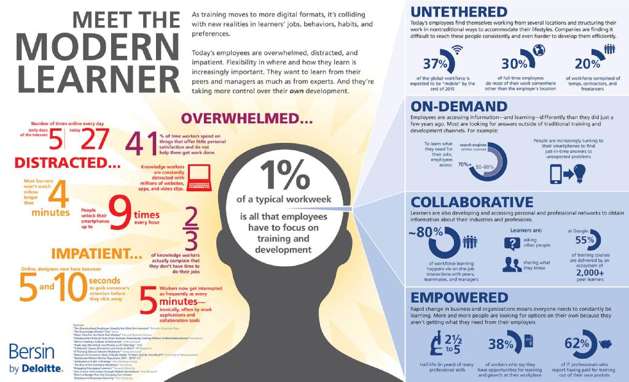
Our Audience: The Modern Learner
Modern learners are impatient, distracted, overwhelmed and mobile – they expect to have learning available when they need it, they learn most of what they need to know by collaborating with others, and they need to learn continuously on their own initiative

Slide 5
Exploring The Modern Learner
You’ve just seen our research based conclusions on learning today – now it’s your turn to explore implications
Working Session Instructions
  Take a minute and read the infographic. At your table take 5 min and please discuss the following:
What surprises you?
Discuss what surprises you
What are the implications?
Discuss what are the implications for on learning for our profession and what you do
How do we need to change?
Discuss in what ways we need to change? And how fast?

Slide 6
Accelerating Development at Deloitte

Slide 7
The Four E’s
Professionals are already learning on their own through these E’s. We believe if you orchestrate these in a holistic fashion you can accelerate development.

Slide 8
Our Vision for Developing our Professionals

Slide 9
A New System for Developing Our People
Our vision for learning is a systematic approach that drives Audit Excellence and aligns with the Holistic Development strategy
Building Core Skills for Audit Excellence
Supporting On-The-Job Performance
Regional/DU Learning Weeks
Just-In-Time “Flash” Learning
Immersive learning experiences designed to build the core skills of Audit Excellence common to all professionals at a given level
A platform for delivering quick-hit learning, accessed at the time of need, to drive on-the-job application of critical knowledge and technical updates
Driving Audit Excellence By…
Developing Beyond Core Skills
Capability Assessments
OTJ Experience & Exposure
Measurement of current capabilities via self and counselor assessment and/or robust evaluation of skills
Personal Development Plans
Elective Courses for Specialized Skills
Level-specific guidance and support for getting the most from on-the-job learning opportunities and networks
Targeted action plans based on assessment results, engagement role, and developmental goals
Elective offerings to build depth and breadth, based on role, individuals learning needs, or interests

Slide 10

-Illustrative- The Learner Experience at Audit Year 4
The following roadmap illustrates one Audit Professional’s journey to build Audit Excellence across the learning year
Learner Profile:
Jen is a second-year Senior and has been in her current role on a large pharmaceutical client for the past two years. Jen has been increasing the scope of her responsibilities across multiple roles, and this year her engagement Partner is counting on her to act as a mentor to two new team members.
Busy Season
Dec | Jan | Feb | Mar | Apr | May | Jun | Jul | Aug | Sep | Oct | Nov | Dec
Assessments
Just-in-Time
Core Learning Week
Jen receives an email notification prompting her to sign up for her preferred Learning Week for Building Audit Excellence
Jen completes an assessment to document her skills, experiences and proficiency against career level expectations
Jen accesses the Just In Time platform throughout the year to learn how to apply key technical topics on the job.
Bite-sized content such as job aids, videos, and Nano modules quickly support her performance
Jen attends her Core Learning Week, where she participates in a simulation, practices applying advance professional and leadership skills, attends sessions focused on high-priority technical updates, and completes a rigorous post assessment
Development Planning
Jen and her counselor work together to create a development plan based on her assessment results, engagement role, and interests to include:
Elective courses
Experience and Exposure
Personalized Development
Jen completes her development plan, including:
Elective Learning: Life Sciences and Up Your Game courses
Experience: Mentors new team members on her engagement
Exposure: Attends pharma sector community meetings
Our Expectations for Learners:
Complete Core Learning week, including all pre- and post-assessment and activity requirements
Complete JIT Learning Pathway to support ongoing learning and development
Complete all elements of a Personal Development Plan, including Professional & Leadership and Industry elective learning, as well as agreed upon Experience & Exposure activities.
Inputs to Performance Management

Slide 11
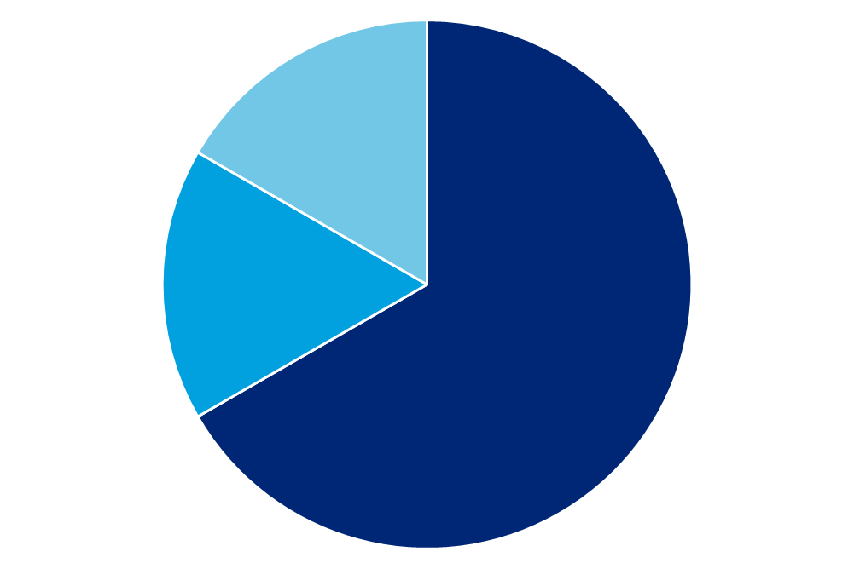
Building Core Skills
What It Could Look Like
  Pre-Requisites
  Regional/DU Core Learning Week
  Follow-Up Learning
  Foundational knowledge learners need before attending the program are communicated along with a recommended roadmap for filling gaps via eLearning courses or reviewing technical guidance/practice aïds.
Focus of the Week
At the end of the program an individual learning plan is updated.
Throughout the year, learners continue to develop in areas covered during the learning week.
How to Apply Technical Knowledge: The primary focus will be on on-the-job application of technical concepts
Advanced Professional Skills: Critical skills for managing engagements and relationships can be developed in the context of technical topics
Leader Development: Skills such as coaching and team/client leadership are integrated into the week.
New CPE Standards

Slide 12
Supporting On-the-Job Performance
Design Parameters for Just-In-Time “Flash” Learning
Structure
A self-service platform providing varying levels of detail to meet learners’ specific needs and generating learning pathways depending on a learner’s level or industry
Content
  Level-specific content will build on Learning Weeks to sustain learning on high-priority topic areas needed to perform and audit
Learner Experience
  Learning pathways would be organized by topical area, sequenced out over the course of the audit year, and comprised of relevant content from a larger portfolio
What It Could Look Like
Content areas and “apps” within the platform could potentially include:
  Job Aids and Toolkits
  Resources to help teams apply technical guidance on a project
  On-Demand Videos
  Short videos featuring experts discussing high priority technical topics
  Nano-Learning Modules
  Bite-sized CPE content delivered via highly engaging methods
  Industry Hot Topics
  Linkage with Hot Topics infrastructure currently under development
New CPE Standards

Slide 13
Developing Beyond Core Skills
Preliminary Design Parameters for Personalized Development
Structure
Offerings will be comprised of elective courses and on-the-job experience and exposure activities recommended or chosen by professionals based career interests, engagement roles, or skill gaps
Content
  An elective course catalog will focus on capability areas that drive ongoing development
  A menu of E&E activities will help professionals align their daily work with their development goals
Learner Experience
  Assessments will tee up development planning by helping professionals understand how their current skills align with career level expectations and long-term career interests
  Development plans will be completed over the course of the year
What It Could Look Like
  Capability Assessment
Professionals’ capabilities can be measured at the start of the of the learning year through assessments that document skills, experiences and proficiency against career level expectations
For specific content areas, professionals could “test out” of courses by demonstrating their capabilities via a robust assessment
Assessment results link to courses and on-the-job learning activities learners use to create their Personal Development Plans
Professionals work with their Counselors to create a Personal Development Plan that addresses assessment results and supports their engagement role and career interests
Personal Development Plans
  Elective Courses
  Experience & Exposure
Elective offerings build depth and breadth based on assessment results, engagement role and career interests
Planned activities and relationships that accelerate on-the-job learning, mentoring, and apprenticeship

Slide 14


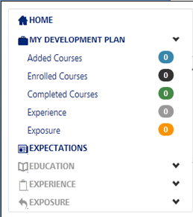
Resources — My Development Plan (MDP)
Visit development.deloitte.com/mdp or jump to “My Development Plan” on DeloitteNet.
Expectations
Provides appropriate recommendations by career level
Education
Specifies the formal learning that supports your skill development
Experience
Suggests job opportunities you should gain at your level
Exposure
Recommends a list of relationships that will foster your career
My Development Plan (MDP) helps you build a strategic, relevant, and actionable development plan by providing you with a list of recommended formal and informal learning opportunities.

Slide 15
My Development Plan
My Development Plan helps professionals to build a strategic, relevant and actionable development plan and to streamline the process for tracking progress against yearly goals.
Track learning hours
    Displaying the hours completed on your plan toward your learning requirement
    Helping you to easily add courses you’ve enrolled in or completed in DLC to your plan
    Providing a curated list of courses that are most relevant for your career level and service line
Set goals and track progress
    Highlighting recommended goals for your career level, in the form of Experiences and Exposures
    Allowing you to track your goals by adding them to your plan as Experiences and Exposures
    Allowing you to document the actions you’ve taken against each goal
Plan for a promotion
    Empowering you to “preview” prescribed courses, experiences and exposures for higher levels by changing your level
Support your counselor’s due diligence
    Enabling you to share your plan - including courses taken, goals and progress - with your counselor
    Allowing you to document the people with whom you’ve interacted and their role so your counselor may easily contact them

Slide 16
The Future of CPE…and learning

Slide 17
Sharing Insights and Addressing Key Questions
We are continuing the change journey from how we’ve traditionally thought about learning, so it’s critical that we address the tough questions
Key Questions:
Do you think this vision has potential to drive higher quality learning for our professionals?
Did you have any “a-ha” moments?
What are the long-term implications for how we operate?

Slide 18
Where we need to go
Our professionals don’t wait. Our cycles and processes take too long and create too much complexity.
Single, uniform standard adopted by all…individual jurisdiction changes/adaptions drive cost and effort and have marginal impact on development
Implement quickly…within a year for all. Pace of change is fast and increasing. We need to keep up.
Evolve rapidly but further evolving the standards to address the following. Establish new task force immediately rather than waiting for next cycle.
  Greater nano learning flexibility
  Development plan credit
  Different models applicable

Slide 19
The future of learning is already here. We need to change or get left behind. Are you willing?

Slide 20
About Deloitte
Deloitte refers to one or more of Deloitte Touche Tohmatsu Limited, a UK private company limited by guarantee (“DTTL”), its network of member firms, and their related entities. DTTL and each of its member firms are legally separate and independent entities. DTTL (also referred to as “Deloitte Global”) does not provide services to clients. Please see www.deloitte.com/about for a detailed description of DTTL and its member firms. Please see www.deloitte.com/us/about for a detailed description of the legal structure of Deloitte LLP and its subsidiaries. Certain services may not be available to attest clients under the rules and regulations of public accounting.
Copyright © 2014 Deloitte Development LLC. All rights reserved.
Member of Deloitte Touche Tohmatsu Limited

