Slide 1
2015 National
Registry Summit
Learning in Action
WELCOME

Slide 2
Statement on standards for
cpe programs: Status update
Jessica Luttrull, associate director
national registry

Slide 3
Proposed Changes to the CPE Standards

Slide 4
CPAs cannot connect the relevance of CPE to what they do and the services provided…

Slide 5
The future workforce is already learning differently
Notes:
Future workforce is already learning differently.
Concepts fully embraced and employed in K-12
Not only is there a different learning preference but also an expectation that continuing education will be available in that learning preference

Slide 6
CPE must evolve with the profession – not looking back but anticipating the future

Slide 7
Evolution
Merriam-Webster offers a definition of “evolution” as a process of continuous change and progression….
to a better state

Slide 8
Changes to CPE Standards
Approach to change has been additive
Keep the current, traditional instructional delivery methods
New delivery methods allow for learning that is more personalized and on demand (just in time)

Slide 9
Changes…
Revised Definitions of Group Live and Group Internet Based
Documentation requirements of developers and reviewers in a technical subject area (CPAs, attorneys and enrolled agents)
Responsibilities for content purchased from another entity
$

Slide 10
Changes…
Interactivity in Group Live programs
Nano-Learning
Blended Learning
Assessments in Self Study

Slide 11
Revised Definitions of Group Live and Group Internet Based

Slide 12
Revised Definitions – Why?
Technology has allowed educational training programs to take place almost any place and any time
Many sponsors want to deliver training at the same time connecting in a variety of ways
Previous definitions of GL and GIB were based on how the instruction was being delivered
RESULT = CONFUSION

Slide 13
Group Live and Group Internet Based
Proposed Changes to the Standards:
Definition is now based on how the participants receive the training program
GROUP LIVE: Synchronous learning in a group environment with real time interaction of an instructor or subject matter expert that provides the required elements of attendance monitoring and engagement
GROUP INTERNET BASED: Synchronous learning on an individual basis with real time interaction of an instructor or subject mater expert with built-in processes for attendance and interactivity

Slide 14
Requirements of Instructors/Developers and Reviewers in Technical Subject Areas

Slide 15
Qualifications of Developers/Reviewers in Technical Subject Areas
Subject
Area
Qualification needed
Accounting
CPA
Proposed Changes to the Standards:
Must be in good standing
Must hold an active license or its equivalent
Auditing
CPA
Tax
CPA, Tax Attorney or Enrolled Agent

Slide 16
Documentation Requirements
Proposed Changes to the Standards:
Must maintain documentation:
CPA and tax attorney:
The state of licensure
License number
Status of license
Enrolled Agent – Information regarding the enrolled agent number

Slide 17
Responsibility for Content Purchased from Another Entity
$

Slide 18
$
Proposed change in CPE Standards:
The organization that issues the certificate of completion under its name is responsible for compliance with all Standards and other CPE requirements.
If a CPE program sponsor plans to issue certificates under its name, it must first consider:
Was content purchased from an entity registered with NASBA on the National Registry?

Slide 19
$
Proposed change in CPE Standards:
If yes,
Sponsor can maintain the author/developer and reviewer documentation from that sponsor
If no,
Sponsor must independently review the purchased content to ensure compliance with the Standards
If sponsor does not have the subject matter expertise on staff, then sponsor must contract with a qualified individual to conduct the review
Documentation maintained as prescribed in Standard No. 24

Slide 20
Interactivity in Group Live

Slide 21
Has anyone… anyone…attended a CPE session like this?

Slide 22
Why?
Our brains can pay full attention only 20 minutes at a time
When the brain is allowed to rest, the brain resets and allows itself to focus on new information
Space is needed between learning sessions
People do not store memories – we grow them
Growth takes time
Adapted from an article by Josh Davis, Maite J. Balda, and David Rock, published in the fifth edition of the NeuroLeadership Journal (2014).

Slide 24
Interactivity in Group Live Delivery Method
Proposed change in CPE Standards:
Each credit of CPE in a group live program must include at least one element of interactivity
Examples:
Group discussion
Polling questions
Instructor-posed question with time for reflection
Use of a case study

Slide 25
Nano-Learning

Slide 26
Nano-Learning – Why?
Neuroscience supports smaller chunks of learning for maximum retention
Desire for just-in-time learning to reinforce concepts
Desire to access learning on demand and mobile

Slide 27
Nano-Learning
Proposed Changes in CPE Standards:
A new instructional delivery method – separate application process on the National Registry
Tutorial content – teach by example and supply information to complete a certain task
Successfully complete assessment of two questions – 100% passing grade
One-fifth credit (0.20 credit) is the maximum credit to be awarded a single nano-learning program

Slide 28
Nano-Learning Example

Slide 29
Blended Learning
Face-to-face classroom style
The Virtual Classroom
Hands-on coaching
Self-paced learning

Slide 30
What is Blended Learning?
Notes:
https://www.youtube.com/watch?v=KD8AUfGsCKg&index=7&list=PLvzOwE5lWqhTv1uCzuAZZZbBJseZP_HwY

Slide 31
Blended Learning – Why?
Personalization for the learner
Drives learner engagement
Controls to some degree the learning experience
Flexible for learning preference styles – a blended approach caters to varying needs
NOT about technology
All about instructional design

Slide 32
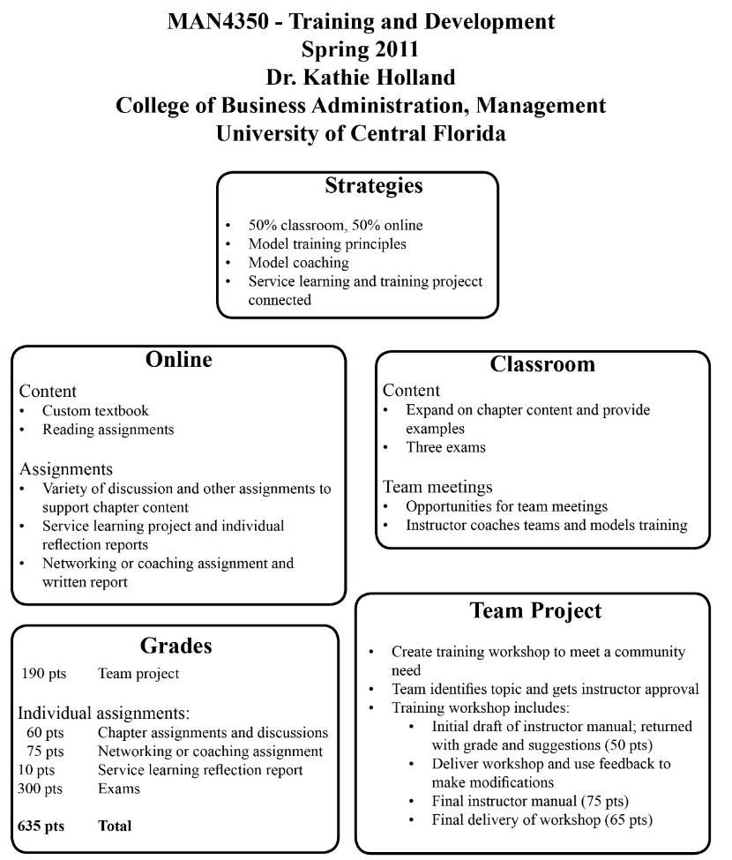
Blended Learning Example

Slide 33
Proposed Changes to CPE Standards:
A new instructional delivery method – separate application process on the National Registry
Any pre-program, post-program and/or homework assignments must relate to the defined learning objectives of the program
CPE program sponsor must provide clear information that summarizes the components of the program and what must be completed or achieved during each component in order to qualify for CPE credits
CPE credits equal sum of the CPE credit for the completed components of the program
CPE credits could be determined based on actual duration time or by pilot test or word count formula as prescribed in the CPE Standards

Slide 34
Assessments for Self Study
Does not measure competency but course completion
Did the learner go through all of the course material and have learning objectives been achieved?

Slide 35
Proposed Changes to the CPE Standards:
Assessments can now occur at the end of modules or significant learning activities
Assessments can be in the form of simulations
Assessment must cover at least 75% of the learning objectives for the program

Slide 36
Timing
Exposure Draft posted May 19, 2015 – public comment period through October 1, 2015
Comments to be submitted to Jessica Luttrull at jluttrull@nasba.org or Clar Rosso at crosso@aicpa.org
$

Slide 37
Questions?

